Slide 1
Rackoon: A Software Solution for Fast Fashion
By: Kaitlyn Chung
CIS 129
December 12, 2024

Slide 2
Act 1.
Research and Problem.

Slide 3
Panning for gold
The problem: I find that when I shop for clothes, I do hours of research to find the BEST product.
If I am going to be spending money on myself (or people I love), I want the product to be something high quality and long-lasting. But most times, I feel like I am digging through garbage to find a gem.

Slide 4
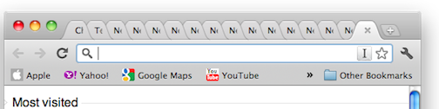
What typically happens
I spend hours combing through reviews on different styles of the same product and scouring Reddit for user recommendations.
I could be looking for something as simple as a pair of blue jeans or a black shoulder bag, or as complicated as the next pair of trendy sneakers to take with me for my honeymoon in Mykonos.
Eventually, I have searched major retailers for their top items. Each retailer may have two or three items that fit the bill, so I will keep those tabs open. Eventually I have twelve tabs open, I am not close to putting anything in my virtual shopping cart, and I have spent at least two hours with nothing to show for it.

Slide 5
Introducing: Rackoon
Rackoon is an application/search engine that ranks clothing and accessories based on user search.
It will use keywords from product reviews that indicate that the item should be purchased (“amazing” for example) or that it should not be purchased (“worst” for example) and rank the items from “should buy” to “avoid” when users search for them.
Searching something like “white t-shirt” should yield a ranked list (#1 to #3) of white t-shirts from a variety of different retailers in a variety of different styles ranked based on positive/negative reviews.

Slide 6

























Slide 7
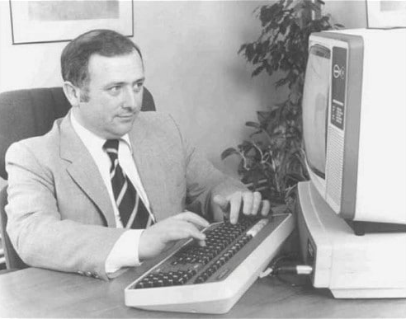
Online Shopping… Without getting online?
Online shopping started with the television in 1984. Videotex allowed people to order groceries from their televisions in the comfort of their homes.
Michael Aldrich’s Videotex system took at-home TV and turned it into a computer terminal years before the World Wide Web was around. Orders entered by remote were sent down the phone line, then packed and delivered by the supermarket.
Michael Aldrich
Notes:
https://www.bbc.com/news/magazine-24091393

Slide 8
The rise of e-commerce
By 1982, the world’s first e-commerce company launched. Still predating the Internet, the Boston Computer Exchange was an online, dial up bulletin board system marketplace for people to buy and sell used computers.
In the mid-90’s, the Internet was established. Amazon was launched in 1995, and was followed by Confinity, known as PyaPal now, a couple years later. Amazon showed early signs of success, being able to ship internationally to 45 different countries within the first 30 days of launch.
Notes:
https://www.visualcapitalist.com/sp/history-of-online-shopping/

Slide 9
E-commerce in the 21st Century
In the 2000s, eCommerce continued to grow with the introduction of Google AdWords and Amazon Prime. By the 2010s, encouraged by the availability digital payment tools, Cyber Monday sales had surpassed $1 billion.
During the 2019 global pandemic, businesses turned to online storefronts with lockdown restrictions driving traffic to the web.

Slide 10
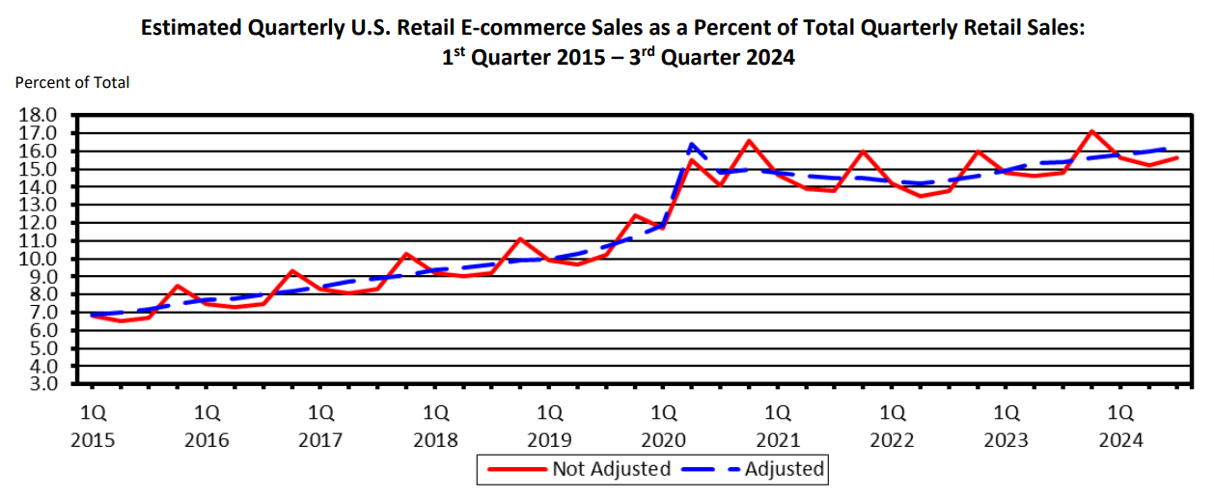
The numbers
By May 2020, eCommerce sales had reached $82.5 billion.
In the United States Department of Commerce’s Q3 2024 retail e-commerce sales report, Q3 sales were estimated to be $300.1 billion. With e-commerce sales accounting for 16.2% of total sales in the U.S.
Source: U.S. Department of Commerce
Notes:
https://www.census.gov/retail/mrts/www/data/pdf/ec_current.pdf

Slide 11


















Slide 12
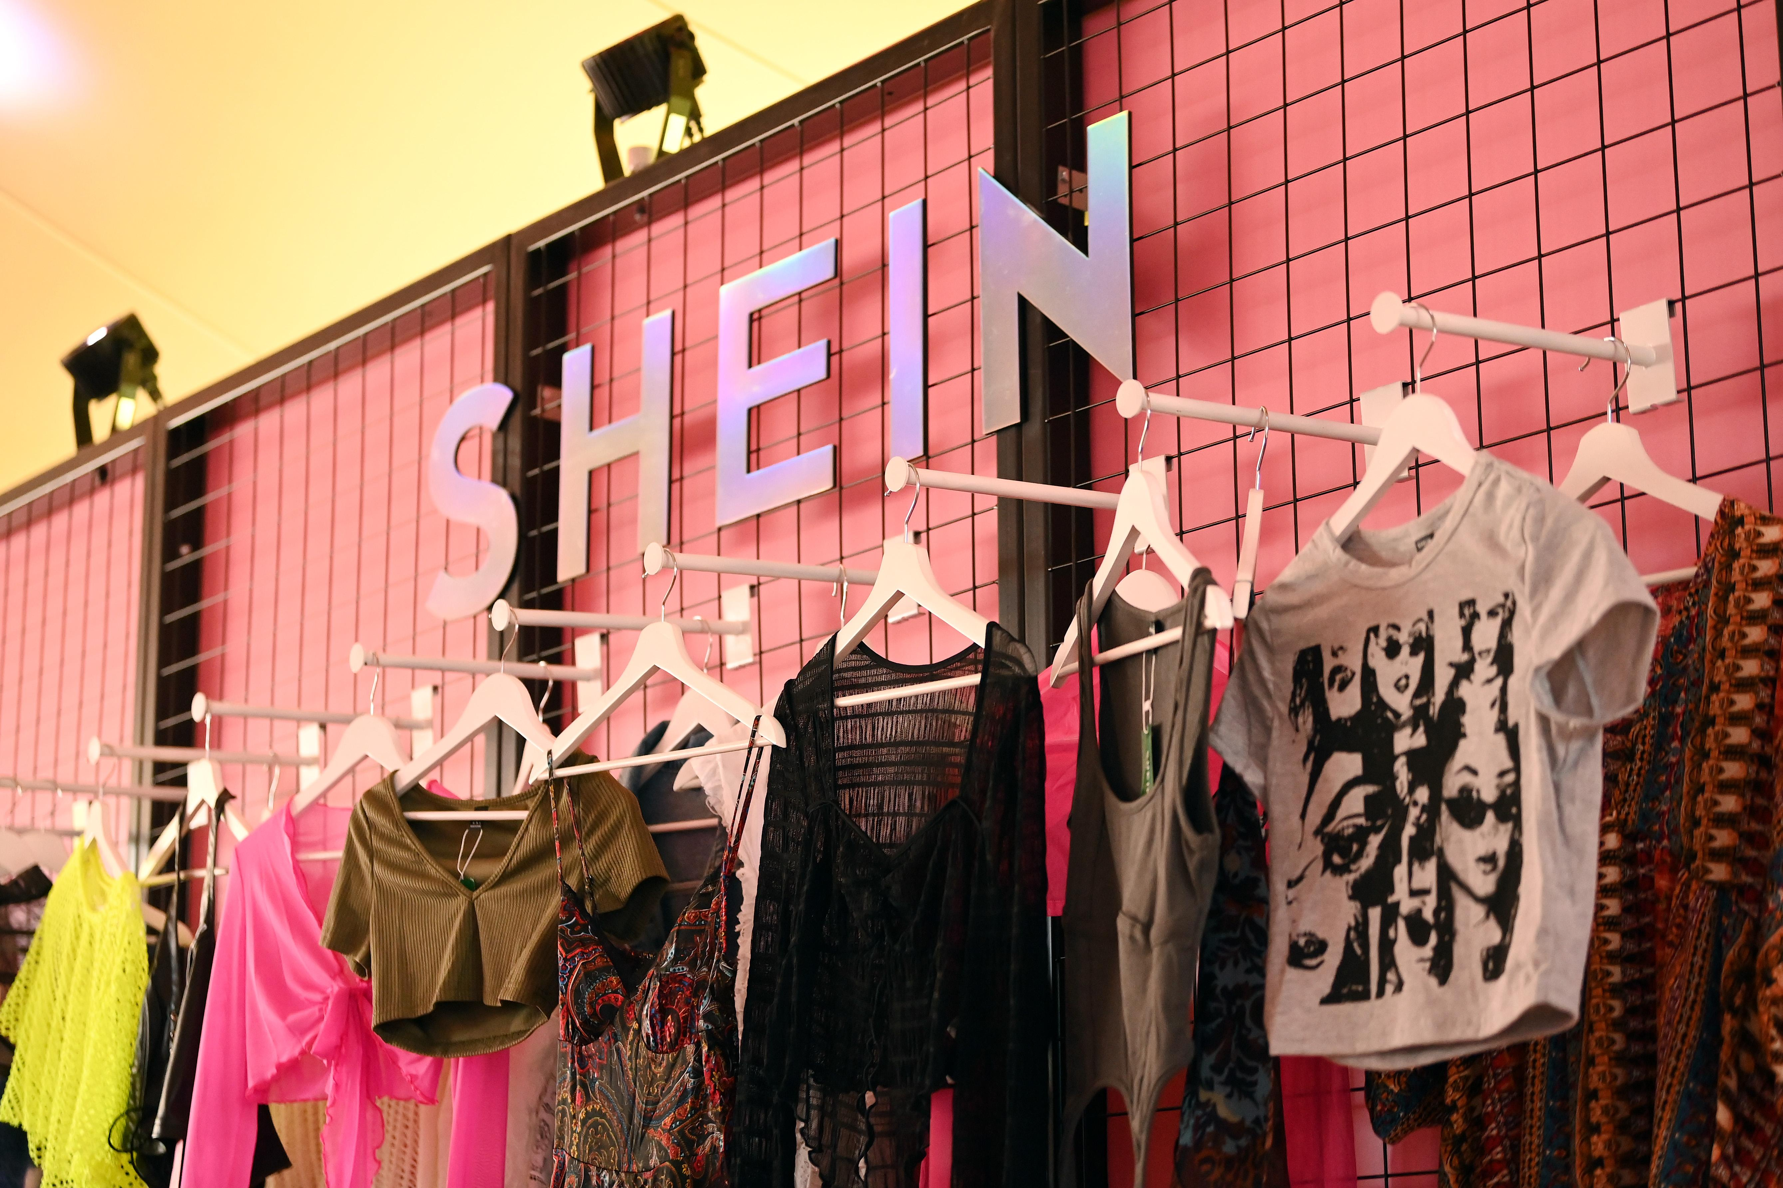
Keeping up with demanding consumer base
The e-commerce, specifically the fashion sector, has received criticism from activists due to the large carbon footprint. Fashion production alone comprises 10% of the total global carbon emissions. These textiles can dry up water sources and pollute rivers and streams.
Fast fashion brands like Shein, Forever 21, UNIQLO, and H&M popular because of their ability to produce the latest fashion trend. But are large contributors to the enviornmental impact.
Notes:
https://earth.org/fast-fashions-detrimental-effect-on-the-environment/

Slide 13
The people behind the hanger
Clothing productions employs primarily young women between the ages of 18 and 24 according to Remake.
Women in Bangladesh make about $96 per month… I did the math that is about $4.80 a day or $0.60 per hour.
The U.S. Department of Labor has found evidence of forced child labor in the fashion industry in countries such as Argentina, Bangladesh, Brazil, China, India, Indonesia, Philippines, Turkey, and Vietnam.
Notes:
https://www.thefashionlaw.com/bangladesh-garment-workers-fast-fashion-brands/

Slide 14































Slide 15
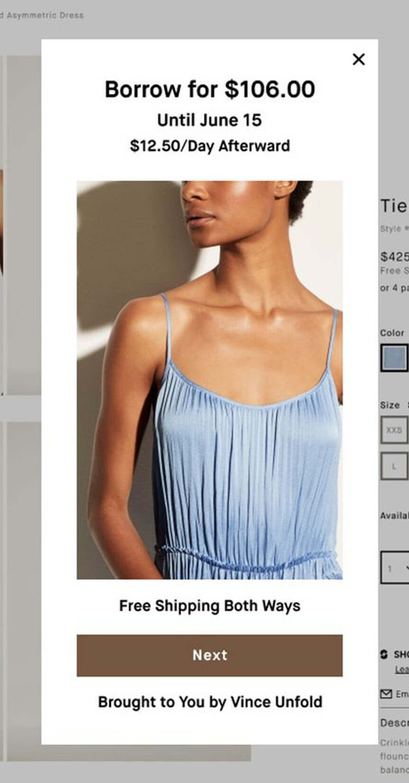
Alternatives to buying
Slow fashion is a newly coined term that reacts to fast fashion and its enviornmental impact.
The World Resource Institute implores consumers to be more sustainable by choosing to support businesses that believe in longevity. For example, services like Rent the Runway and Vivrelle allow members to borrow clothes and designer handbags.
Source: Vince Unfold
Notes:
https://www.wri.org/insights/numbers-economic-social-and-environmental-impacts-fast-fashion

Slide 16
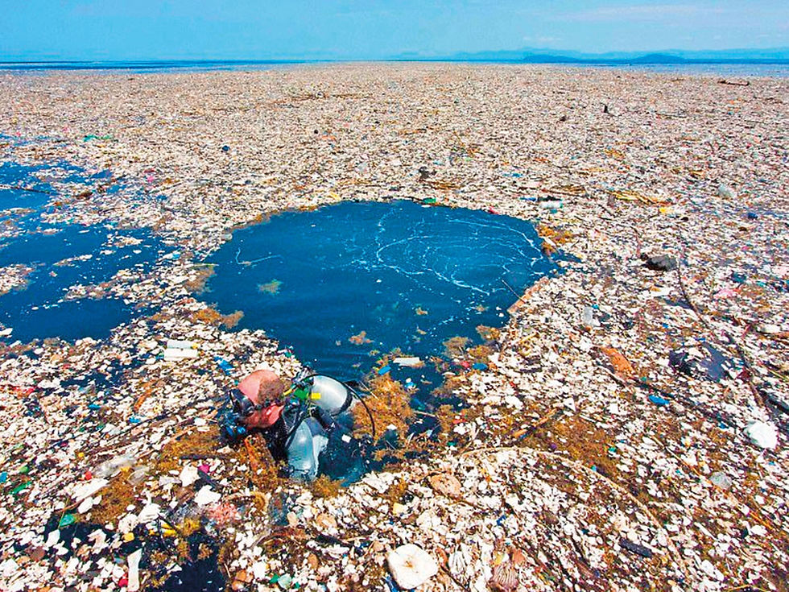
If you buy less, companies produce less
Consumers have also opted to buy secondhand (Depop and Poshmark for example) or thirft items, and retailers like Adidas have experimented with personalized apparel to cut down on returns.
Less returns = less textiles end up in oceanic garbage patches.
The Great Pacific Garbage Patch
Notes:
https://www.wri.org/insights/numbers-economic-social-and-environmental-impacts-fast-fashion

Slide 17
What happens when you need to buy new?
I do not mind thrifting or buying secondhand.
However, there will always be situations where consumers need to purchase something new. Whether that be baby clothes, undergarments, shoes, there should be a way to be more mindful about the products that we are adding to our cart.
When researching tools to help consumers find high quality and long-lasting garments, no such tools were available.
Notes:
https://www.wri.org/insights/numbers-economic-social-and-environmental-impacts-fast-fashion

Slide 18
Act 2.
Design a solution.

Slide 19
Real-World Applications I
I have been looking to replace the white tennis shoes that I wear to work every single day.
I don’t want the pair that I previously bought. Those were nice and lasted a good amount of time for me, but I want to try something new.
In Rackoon, I could search “casual white tennis shoe” and a list will pop up of the top 3 casual white tennis shoes based on reviews from other people that have purchased the product. The more positive reviews, the higher the ranking. Based on my budget, I may opt for the #1. If not, I have two other options to look at.

Slide 20
Real-World Applications II
It’s your mother-in-law’s birthday. And you know she has been wanting a new winter coat for when she goes on work trips to Michigan. You are Arizona born. You have no idea what makes a good winter coat or even where to start.
In Rackoon, you search “winter coat” and a list will pop up of the top 3 winters coats would pop up. Say you were not specific enough. You have a list of three wrong winter coats. But #2 looks close..ish to what you were looking for. Similar to Pinterest, in that listing there is an option to look at similar styles to get a new top three. You may have to do this a few times, but eventually you will find a great coat to gift her!

Slide 21
Simplifying things
I have basic programming skills. What I have dreamed up in this presentation would be extremely difficult for me alone to achieve with my skillset.
As a result, I will be simplifying the concepts into things that I have learned how to do, with the idea that they can be easily scaled up with the right scripts and coding background.

Slide 22
The design approach
Find five different styles for the same kind of product.
Import reviews from each.
Search the review for positive (“good”, “happy”, “amazing”) versus negative (“bad”, “worst”, “awful”) keywords
Use a counter to track these words (+1 for positive, -1 for negative)
Rank the styles (#1-3) based on the net score from the counter.
2/5 will not be displayed
Display the ranking in order. Display the name, score, and price of the item.

Slide 23
Act 3.
The actual software design.

Slide 24
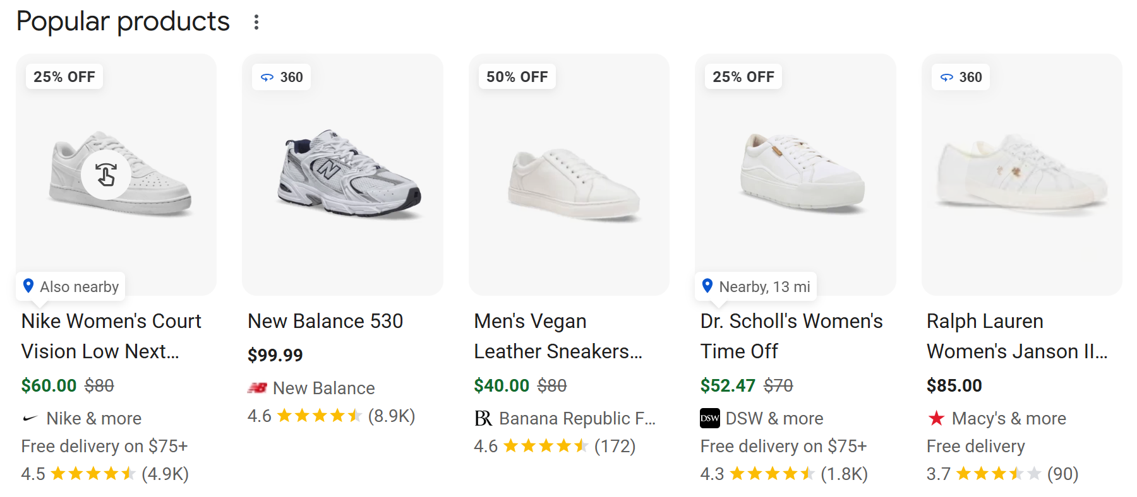
1. Search for five different styles of white casual sneaker.
To make things easy, I Googled “casual white sneaker.” I will use the top five results for this project:

Slide 25
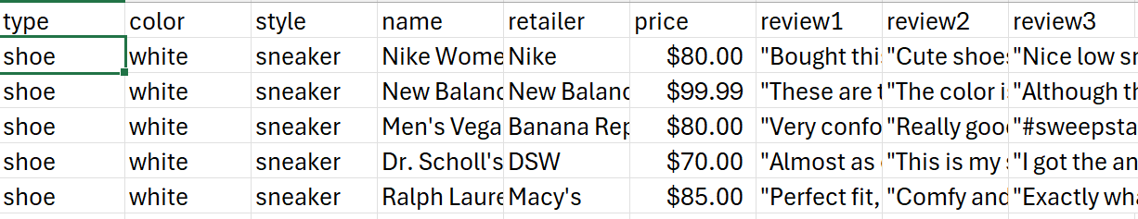
2. Import the first three reviews from each.
These can be stored in a .csv file. For purposes of this project, I will make an Excel sheet with relevant information and save the file as a .csv file that I can then import and extract data from. Each review is saved as review1, review2, and review3.
At this point, I am assuming that someone will be able to extract this data into a .csv file for these downstream applications.

Slide 26
3. Create a Product class
Create a class Product
Initialize private variables of type, color, style, name, retailer, price, review1, review2, review3, score
Create getters of type, color, style, name, retailer, price, review1, review2, review3, score
Create setter methods of type, color, style, name, retailer, price, review1, review2, review3, score

Slide 27
3. Create a counter function
Define function keepScore(review):
Integer variable score
Initialize score to 0
If “good”, “happy”, “amazing” in review
Add 1 to score
If “bad”, “worst”, “awful” in review
Add -1 to score
Else
Add 0 to score
Return score

Slide 28
4. Scan the reviews for positive versus negative keywords (with keepScore function)
Import shoes.csv
Read the .csv file
Create an object for each new product (each row)
Set the type, color, style, name, retailer, price,
review1, review2, review3
Create reviews list of review1, review2, review3
For index in reviews:
Set score for object to keepScore(index)

Slide 29
5. Rank the styles (#1-3) based on the net score from the counter.
Create dictionary items of key-value pairs containing each object’s name and score
Sort items in descending order based on the score
Store the sorted list as ranked_items

Slide 30
6. Display the ranking in order. Display the name, score, and price of the item.
For the top three ranked_items
Display the name, score, and price
Format the display to look like this:
Name | Score | Price
Nike Women's Court Vision Low Next Nature | 10 | $80
Dr. Scholl's Women's Time Off | 6 | $70
Men's Vegan Leather Sneakers White Regular | 3 | $80

Slide 31
User interface
When users search for a product, I am imagining a page where the products are ranked with the top product showing first. Followed by the second and third.
Each rank would display a ranking, picture of the product, the score, price, and link to purchase. As well as any tags that we used to sort the product initially (shoe, white, sneaker, for example)

Slide 32
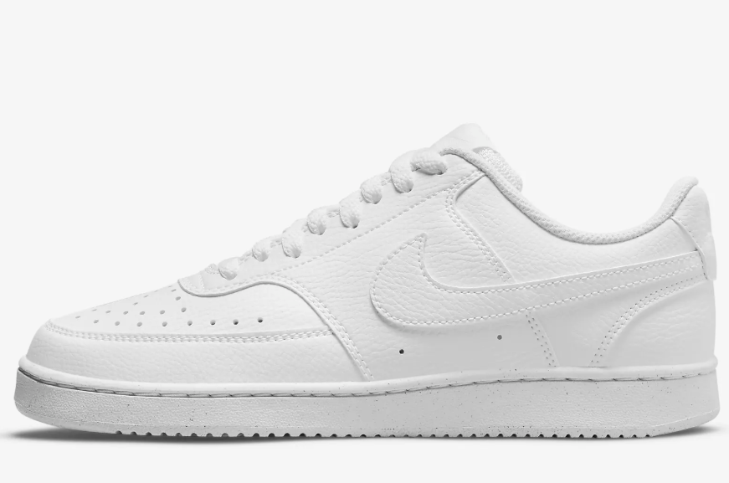
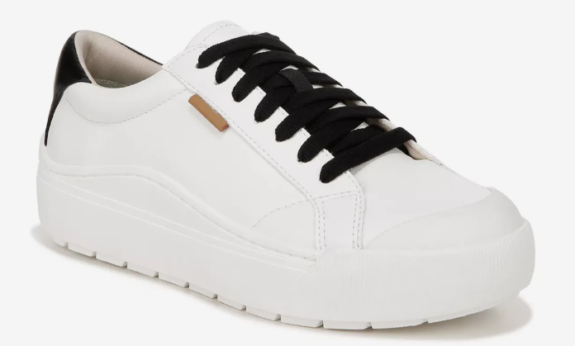
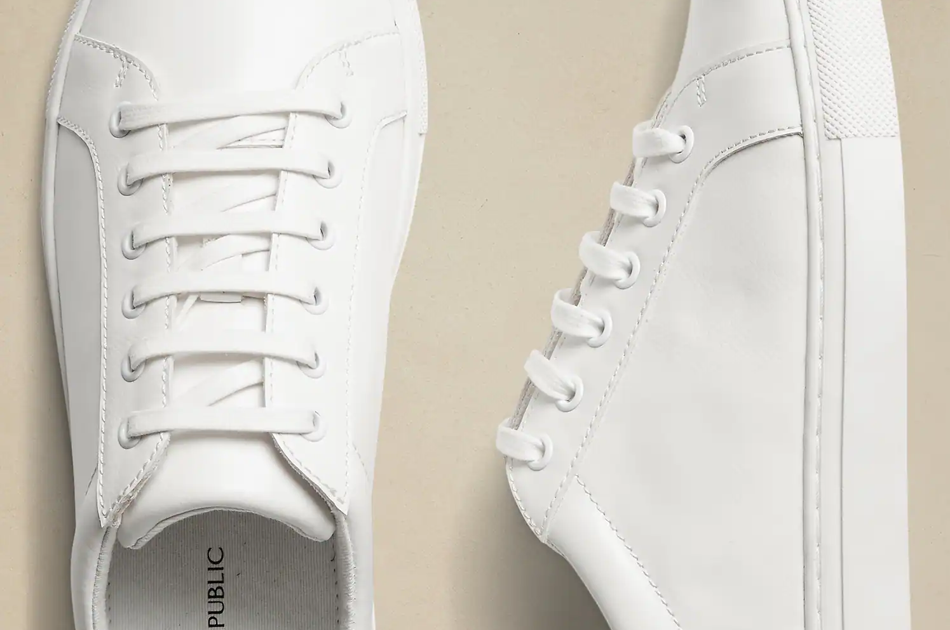
The vision:
#1
Score: 10
Nike Court Vision Low Next Nature
white
shoe
sneaker
casual
Nike
#2
Score: 6
Dr. Scholl's Women's Time Off
white
shoe
sneaker
casual
Dr. Scholl’s
#3
Score: 10
Men's Vegan Leather Sneakers White Regular
white
shoe
sneaker
casual
leather

Slide 33
Unanswered Questions
How will the application deal with fake user reviews? I could see companies trying to boost their own product by entering more reviews for their product so that it ranks higher than competitor products.
How will the application update with new products (and when old products get discontinued)? Say a new pair of white sneakers enters the market, there needs to be a way where the software works in real time to continually scan user reviews for new products.

Slide 34
Sources
Ang, C. (2021, July 5). Timeline: Key events in the history of online shopping. Visual Capitalist. https://www.visualcapitalist.com/sp/history-of-online-shopping/
Census Bureau of the Department of Commerce. (2024). QUARTERLY RETAIL E-COMMERCE SALES [Press-
release]. https://www.census.gov/retail/mrts/www/data/pdf/ec_current.pdf
Kelly, D. W. a. J. (2013, September 16). Online shopping: The pensioner who pioneered a home shopping
revolution. BBC News. https://www.bbc.com/news/magazine-24091393
Maiti, R. (2024, May 30). Fast fashion and its environmental impact in 2024 | Earth.Org. Earth.Org.
https://earth.org/fast-fashions-detrimental-effect-on-the-environment/
Reichart, E. (n.d.). By the Numbers: The Economic, Social and Environmental Impacts of “Fast Fashion.”
World Resources Institute. https://www.wri.org/insights/numbers-economic-social-and-
environmental-impacts-fast-fashion
TFL. (2020, March 1). Bangladeshi Garment Workers, Unions Say New Minimum Wage is a “Cruel Joke,”
Call On Brands to Pay More. The Fashion Law. https://www.thefashionlaw.com/
bangladesh-garment-workers-fast-fashion-brands/

